Slide 1


Introduction to Computer Science
Reichman University
Recitation 3
Notes:
‹#›

Slide 2
Overview
Functions
Function signature
Function params
void, return type
Error control
Overloading
Overflow
Java Doc

Slide 3
Question 0 – Longest Sequence
A substring of identical letters is simply a sequence of the same letter inside a given string.
Design a program which does the following:
Receives from the user a command line non-empty string.
Finds the longest sequence of identical letters.
Prints the sequence to the user.
% java LongestSequence aaabbbbccc
The longest sequence is : bbbb
% java LongestSequence “I took the dog for a walk”
The longest sequence is : oo
Notes:
‹#›
This question is interview level..

Slide 4
Question 0 - Solution
public class LongestSequence {
public static void main (String[] args) {
String text = args[0];
// initialize the longest char to some arbitrary value.
char longest = ' ';
char curChar = text.charAt(0);
int maxLength = 0;
int curLength = 0;
// loop over the text, for each letter find how many times it appears consecutively
// then decide which letter appears in the longest sequence and how many times.
for (int i = 0 ; i < text.length() ; i++) {
char chr = text.charAt(i);
boolean flag = false;
if (chr == curChar) {
curLength++;
} else {
flag = true;
}
if (curLength > maxLength) {
maxLength = curLength;
longest = chr;
}
// If flag is false (same char), keep current length, otherwise reset to 1
curLength = !flag ? curLength : 1;
// If flag is false (same char), keep current char, otherwise update to new char
curChar = !flag ? chr : text.charAt(i);
}
// print the longest sequence
System.out.print("The longest sequence of identical letters is : ");
for (int j = 0; j < maxLength; j++) {
System.out.print(longest);
}
System.out.println(); // convention
}
}
Notes:
‹#›

Slide 5
Question 0 - Another Solution
public class LongestSequence {
public static void main (String[] args) {
String text = args[0];
// initialize the longest char to some arbitrary value.
char longest = ' ';
int maxLength = 1;
int curLength = 1;
// loop over the text, if the current letter is equal to the previous letter, increase curLength, save the
// maxLength and which letter appears in the longest sequence
for (int i = 1 ; i < text.length() ; i++) {
char curChar = text.charAt(i);
char prevChar = text.charAt(i-1);
if (curChar == prevChar) {
curLength++;
} else {
curLength = 1;
}
if (curLength > maxLength) {
maxLength = curLength;
longest = text.charAt(i);
}
}
// print the longest sequence
System.out.print("The longest sequence of identical letters is : ");
for (int j = 0; j < maxLength; j++) {
System.out.print(longest);
}
System.out.println(); // convention
}
}
There is more than one correct solution. to every problem
A way to improve yourself is see code written by other people which has a different way of thinking and see their solution (if it is correct).
Notes:
‹#›

Slide 6
Question 1 – Substrings
A substring of a string, is any string which is wholly contained in the original string.
Examples:
“kawa” is a substring of “kawa banga”
“banga” is a substring of “kawa banga”
“wa ba” is a substring of “kawa banga”
“hi” is not a substring of “kawa banga”
“kawabanga” is not a substring of “kawa banga”
Design a program which does the following:
Receives two non-empty strings from the users.
Checks if the first string is a substring of the second.
Lets the user know.
Notes:
‹#›

Slide 7
Question 1 - Solution
public class IsSubstring {
public static void main(String[] args){
String a = args[0];
String b = args[1];
boolean isSub = false;
int lastIndex = b.length() – a.length() + 1;
for (int i = 0; i < lastIndex && !isSub ; i++){
if (a.charAt(0) == b.charAt(i)){
isSub = true;
for (int j = 0; j < a.length() && isSub ; j++){
isSub = (a.charAt(j) == b.charAt(i + j));
}
}
}
System.out.println(isSub);
}
}
Notes:
‹#›

Slide 8
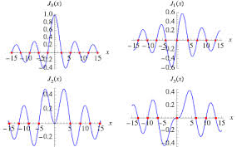
Functions
Introduction to Computer Science
Reichman University
Recitation 3
Notes:
‹#›

Slide 9
Functions
Functions are independent part of a code which do a certain operation.
Functions may have input and may have output.
Functions are essential tool for developers.
When I need to build a helper function ?
DRY Method -> Don’t Repeat Yourself
If you have a code which has certain input, get certain output and don’t influence the rest of your code.
Notes:
‹#›

Slide 10
Function anatomy
type of return value
function name
argument type
argument name
function signature
public static double sqrt (double x, double epsilon) {
if (x < 0) {
return Double.NaN;
}
double r = x;
while (Math.abs(r * r - x) > epsilon) {
r = (x / r + r) / 2.0;
}
return r;
}
error control for input validation
local variable
function
body
call to another function
return value

Slide 11

Determine the Outputs
public static void main(String[] args){
int x = 1;
System.out.println(x);//1
add5(x);
System.out.println(x);//1
}
public static void add5(int y){
y = y + 5;
}
if the type of the return value is void means no value is returned
Notes:
‹#›

Slide 12
Determine the Outputs
public static void main(String[] args){
int x = 1;
System.out.println(x);//1
add5(x);
System.out.println(x);//1
}
public static int add5(int y){
y = y + 5;
return y;
}
return type must match the type mentioned in the signature. if not must me matched
Notes:
‹#›

Slide 13
Determine the Outputs
public static void main(String[] args){
int x = 1;
System.out.println(x);//1
x = add5(x);
System.out.println(x);//6
}
public static int add5(int y){
y = y + 5;
return y;
}
Notes:
‹#›

Slide 14
Question 1, Expansion 1 – Substrings
A substring of a string, is any string which is wholly contained in the original string.
Examples:
“kawa” is a substring of “kawa banga”
“banga” is a substring of “kawa banga”
“wa ba” is a substring of “kawa banga”
“hi” is not a substring of “kawa banga”
“kawabanga” is not a substring of “kawa banga”
Design a function which:
Receives two non-empty strings from the users.
Checks if the first string is a substring of the second.
Notes:
‹#›

Slide 15
Question 1, Expansion 1 - Solution (Converted into function)
public static boolean isSubstring(String smaller, String bigger){
boolean isSub = false;
int lastIndex = bigger.length() – smaller.length() + 1;
for (int i = 0; i < lastIndex && !isSub ; i++){
if (smaller.charAt(0) == bigger.charAt(i)){
isSub = true;
for (int j = 0; j < smaller.length() && isSub ; j++){
isSub = (smaller.charAt(j) == bigger.charAt(i + j));
}
}
}
return isSub;
}
Notes:
‹#›

Slide 16
Question 1, Expansion 2 - Valid password
To keep our information online secured, some applications require that we define a password for our account.
To prevent hacking into our account, (and give the hackers a hard time) we need to choose strong passwords. In most applications the password must be at least n characters long, and contain at least 1 lowercase letter, 1 uppercase letter, and 1 digit.
Write a function that receives a password (String) and returns true if it’s a valid password or false if not under the following rules:
The password must be 6 character long.
The password must have at least 1 uppercase letter.
The password must have at least 1 lowercase letter.
The password must have at least 1 digit.
Notes:
‹#›

Slide 17
Question 1, Expansion 2 - Valid password
//Receives a String pass and returns if its a valid password
public static boolean isValid(String pass){
boolean len = pass.length() >= 6;
boolean capital = false;
boolean small = false;
boolean digit = false;
if (!len){
return false;
}
for (int i = 0; i < pass.length(); i++){
if (!small && pass.charAt(i) >= 'a' && pass.charAt(i) <= 'z') {
small = true;
}
if (!capital && pass.charAt(i) >= 'A' && pass.charAt(i) <= 'Z') {
capital = true;
}
if (!digit && pass.charAt(i) >= '0' && pass.charAt(i) <= '9') {
digit = true;
}
}
return (capital && small && digit);
}
// discussion why the last line is not: return (capital && small && digit && len); ?
Notes:
‹#›

Slide 18
Question 1, Expansion 2 - Valid password (another version, continue)
//Receives a char ch and returns true if its a valid digit
public static boolean isDigit(char ch){
return ch >= '0' && ch <= '9';
}
//Receives a char ch and returns true if its a valid upper case letter
public static boolean isUpper(char ch){
return ch >= 'A' && ch <= 'Z';
}
//Receives a char ch and returns true if its a valid lower case letter
public static boolean isLower(char ch){
return ch >= 'a' && ch <= 'z';
}
Notes:
‹#›

Slide 19
Question 1, Expansion 2 - Valid password (another version)
//Receives a String pass and returns if its a valid password
public static boolean isValid(String pass){
boolean len = pass.length() >= 6;
boolean capital = false;
boolean small = false;
boolean digit = false;
if (!len){
return false;
}
for (int i = 0; i < pass.length(); i++){
char curChar = pass.charAt(i);
if (!small && isLower(curChar)) {
small = true;
}
if (!capital && isUpper(curChar)) {
capital = true;
}
if (!digit && isDigit(curChar)) {
digit = true;
}
}
return (capital && small && digit);
}
Notes:
‹#›
Discuss helper functions

Slide 20
Question 1, Expansion 2 - Valid password – testing solution
public class ValidPassword {
public static void main (String[] args) {
String password = args[0];
boolean valid = isValid(password);
if (valid) {
System.out.println("the password is valid");
} else {
System.out.println("the password is not valid");
}
}
public static boolean isValid(String pass) {
. . .
}
}
% java ValidPassword yael
the password is not valid
% java ValidPassword a3eT65e
the password is valid
Notes:
‹#›

Slide 21
Question 1, Expansion 3 - Valid password
Let's expand. Some applications go one step above it, and doesn’t allow the password to contain the first name of the user.
Write a function that receives a password (String), and a name (String of only letters) and returns true if it’s a valid password based on the following conditions:
The password must be 6 character long.
The password must have at least 1 uppercase letter.
The password must have at least 1 lowercase letter.
The password must have at least 1 digit.
The password must not contain the name of the user.
You may assume that the name appears in lowercase inside the password.
The name is only lowercase letters.
Notes:
‹#›

Slide 22
Question 1, Expansion 3 - Solution
//Receives a String pass and returns if its a valid password
public static boolean isValid(String pass, String name){
boolean len = pass.length() >= 6;
boolean capital = false;
boolean small = false;
boolean digit = false;
if (!len || isSubstring(pass, name)){
return false;
}
for (int i = 0; i < pass.length(); i++){
char curChar = pass.charAt(i);
if (!small && isLower(curChar)) {
small = true;
}
if (!capital && isUpper(curChar)) {
capital = true;
}
if (!digit && isDigit(curChar)) {
digit = true;
}
}
return (capital && small && digit);
}
Notes:
‹#›

Slide 23
Question 1, Expansion 3 – testing solution
% java ValidPassword yael dan
the password is not valid
% java ValidPassword yaelL123 yael
the password is not valid
% java ValidPassword a3eT65e yael
the password is valid
public class ValidPassword {
public static void main (String[] args) {
String password = args[0];
String name = args[1];
boolean valid = isValid(password, name);
if (valid) {
System.out.println("the password is valid");
} else {
System.out.println("the password is not valid");
}
}
public static boolean isValid(String pass) {
. . .
}
}
Notes:
‹#›

Slide 24
Question 2 – Primal Decomposition
The fundamental theorem of arithmetic states is that every positive integer greater than 1 can be written as a product of prime numbers in a unique way.
Examples:
6 = 2 x 3
18 = 2 x 3 x 3
7 = 7
35 = 7 x 5
Write a program which:
Reads n, a command line integer.
Prints the unique way to write n as a product of primes.
% java PrimalDecomposition 21
21 = 3*7
% java PrimalDecomposition 100
100 = 2*2*5*5
% java PrimalDecomposition 4539
4539 = 3*17*89
Notes:
‹#›

Slide 25
Question 2 – Primal Decomposition - Solution
Recall the program from last week which checks if a given positive integer is prime.
We can transform the code into a function.
public static boolean isPrime(int num) {
if (num < 2) {
return false;
}
for (int i = 2; i < num; i++) {
if (num % i == 0) {
return false;
}
}
return true;
}
Notes:
‹#›

Slide 26
Question 2 – Primal Decomposition - Solution
public static String primalDecomposition(int max) {
String result = "";
// for each number up to max check if its prime, if so check
// how many times it divides by max
// and print it the required amount of times.
for (int i = 2; i <= max; i++) {
if (isPrime(i)) {
while (max % i == 0) {
max = max / i;
if (max != 1) {
result += i + "*";
} else {
result += i;
}
}
}
}
return result;
}
Notes:
‹#›
How can we improve this code?
exit once N is 1, only run until sqrt(N)..
isPrime(i) is redundent

Slide 27
Question 3 – Factorial
One of the few functions which aren’t supported by Math library is factorial.
Factorial is a function which receives a nonnegative number (n) and return the multiplication of every positive number up to that point, the function is denoted n!:
2! = 1 * 2
5! = 1 * 2 * 3 * 4 * 5
0! = 1
n! = 1 * 2 * …. * (n-1) * n
The factorial function is used in permutations, combinations, and various other mathematical and statistical computations.
Design a function which calculates the operation.
Notes:
‹#›

Slide 28
Question 3 – Factorial
public static int factorial(int n) {
int ans = 1;
for (int i = 1; i <= n; i++) {
ans *= i;
}
return ans;
}

Slide 29
Question 3 – Factorial
Let's test our function
public static void main(String [] args) {
System.out.println(factorial(1));
System.out.println(factorial(0));
System.out.println(factorial(5));
System.out.println(factorial(-1));
System.out.println(factorial(20));
}
Expected output:
1
1
120
error of sort
2432902008176640000

Slide 30
Question 3 – Factorial
Let's test our function
public static void main(String [] args) {
System.out.println(factorial(1));
System.out.println(factorial(0));
System.out.println(factorial(5));
System.out.println(factorial(-1));
System.out.println(factorial(20));
}
Expected output:
1
1
120
error of sort
2432902008176640000
Actual output:
1
1
120
1
-2102132736

Slide 31
Question 3, Expansion 1 – Factorial, Error Control
Let's focus first on the first error, and fix it,
When you get an input which should be invalid, or rather have a value which indicates that something happen/didn’t happen you want to return a value which will tell you what went wrong inside the function. We will want to return a value which represent an error of some sort.
When the function returns a String value that is easy. However, what do I do when my function returns an int? or other type?
You return a value which the function cannot return regularly. We already saw an example for that in the method str.indexOf(char ch).
if the char ‘ch’ wasn’t found, we will just return -1. Since in java there is no -1 index in the string.
Example: ”hello”.indexOf(‘A’);
Will result -1.
Actual output:
1
1
120
1
-2102132736

Slide 32
Question 3, Expansion 1 – Factorial, Error Control
That for every non-negative integer n, the claim: n! <= (n+1)!, holds.
Therefore, 0! is the smallest value which is 1 since 0, can have other purposes (next recitation) we will use -1.
Why we rather use -1 over 3 ? Its easier to notice that there is something wrong.
public static int factorial(int n) {
if (n < 0){
return -1;
}
int ans = 1;
for (int i = 1; i <= n; i++) {
ans *= i;
}
return ans;
}
error control for input validation
Notes:
‹#›

Slide 33
Question 3, Expansion 1 – Factorial, Error Control
Let’s test our function after the change
public static void main(String [] args) {
System.out.println(factorial(1));
System.out.println(factorial(0));
System.out.println(factorial(5));
System.out.println(factorial(-1));
System.out.println(factorial(20));
}
Expected output:
1
1
120
error of sort
2432902008176640000
Actual output:
1
1
120
-1 // changed
-2102132736

Slide 34

Question 3, Expansion 2 - What happened?
Let’s move to the other problem.
First, let’s understand why the value not make sense?
20! = 1 * 2 * 3 * … * 20
As we recall, in factorial we only multiply positive numbers with other positive numbers, therefore, the result should be always be positive, yet the number -2102132736 is a negative number.
So, what happened here???
overflow

Slide 35
Question 3, Expansion 2 - Overflow
What is overflow?
As we know, each number representing whole number has a max value, and a min value.
We both stored the value and returned it as int. If you recall int type has max value of 2,147,483,647, the value of 20! (2,432,902,008,176,640,000), exceeds it. Therefore, it moved to the minimum value of int.
Let's look at byte, to understand it with more manageable numbers.
Reminder: The min value of byte is -128, the max value of byte is 127.
If I was to write the following code:
It will cycle back to the min value of byte, which is -128, hence b will be -128.
You must be thinking ok you will know that these things in advance, but this is not always the case, this bug appeared, got mainstream media attention.
public static void main(String [] args) {
byte b = 127;
b += 1;
System.out.println(b);
}

Slide 36
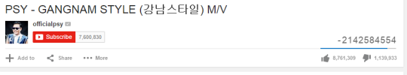

Overflow - Problem from real life
In December 2014, The song “Gangnam Style” by the artist PSY was the most played video on Youtube (at that time) and reached 2.1 billion views.
Youtube stored the view numbers of a video as an int, therefore, once it reached the max value of int which is 2,147,483,647 it overflowed and switched into negative number of views.
So, they had to change the value stored the views variables into long.
Let’s apply the same solution to our code.
https://www.vox.com/2014/12/3/7326945/gangnam-style-got-so-many-views-that-it-nearly-broke-youtube

Slide 37
Question 3, Expansion 2 – Overflow
public static long factorial(long n) {
if (n < 0){
return -1;
}
long ans = 1;
for (long i = 1; i <= n; i++) {
ans *= i;
}
return ans;
}
Notes:
‹#›

Slide 38
Question 3, Expansion 2 – Factorial
Let’s test our function after the change
public static void main(String [] args) {
System.out.println(factorial(1));
System.out.println(factorial(0));
System.out.println(factorial(5));
System.out.println(factorial(-1));
System.out.println(factorial(20));
}
Expected output:
1
1
120
error of sort
2432902008176640000
Actual output:
1
1
120
-1
2432902008176640000 // changed

Slide 39
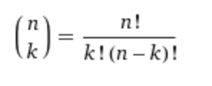
Question 3, Expansion 3 – Binomial coefficient
The binomial coefficient, often referred to as "n choose k" or "combinations", is a fundamental concept in combinatorics. It represents the number of ways to choose
k items from a set of n items without replacement and without order.
Where:
Design a program which implement the method
Notes:
‹#›

Slide 40
Question 3, Expansion 3 – Solution
public class BinomialCoefficient {
public static void main(String[] args) {
long n = Integer.parseInt(args[0]); //GOOD NAME DUE TO FORMULA
long k = Integer.parseInt(args[1]); //GOOD NAME DUE TO FORMULA
System.out.println(binomial(n, k));
}
public static long binomial(long n, long k) {
if (n < 0 || k < 0){
return -1;
}
long numerator = factorial(n);
long denoPart1 = factorial(k);
long denoPart2 = factorial(n - k);
return numerator / (denoPart1 * denoPart2);
}
public static long factorial(long n) {
if (n < 0){
return -1;
}
long ans = 1;
for (long i = 1; i <= n; i++) {
ans *= i;
}
return ans;
}
}
Notes:
‹#›
the result of 30! exceeds even the long limit (exceeds at 22). Need to know and check the edge cases.

Slide 41
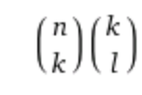
Question 3, Expansion 4 – Students Union
Consider the following problem.
You have a class of n students. k of these students need to participate in the student union. l of the students in the union need to be part of the students’ council.
In how many ways can you choose a student union and council?
The answer is purely combinatorial:
Write a program which:
Reads n,k,l as command line arguments. Such that n > k and k > l.
Prints the number of ways a students union/council can be assembled.
% java StudentsUnion 10 5 2
2520
% java StudentsUnion 15 8 4
450450
Notes:
‹#›

Slide 42
Question 3, Expansion 4 - Solution
public class StudentsUnion {
public static void main(String[] args) {
long n = Integer.parseInt(args[0]); //GOOD NAME DUE TO FORMULA
long k = Integer.parseInt(args[1]); //GOOD NAME DUE TO FORMULA
long l = Integer.parseInt(args[2]); //GOOD NAME DUE TO FORMULA
System.out.println(binomial(n,k) * binomial(k,l));
}
public static long binomial(long n, long k) {
if (n < 0 || k < 0){
return -1;
}
long numerator = factorial(n);
long denoPart1 = factorial(k);
long denoPart2 = factorial(n - k);
return numerator / (denoPart1 * denoPart2);
}
public static long factorial(long n) {
if (n < 0){
return -1;
}
long ans = 1;
for (long i = 1; i <= n; i++) {
ans *= i;
}
return ans;
}
}
Notes:
‹#›
the result of 30! exceeds even the long limit (exceeds at 22). Need to know and check the edge cases.

Slide 43
Overloading
Consider the following, System.out.println(), is a function.
How come you can print a String and you print an int with the same System.out.println() function? Since the signature of the function supposed to be different?
Definition: Functions will be overloading functions if they share the same name under the same scope.
Two functions can have the same name if and only if they have some difference in signature, which means a difference their parameters. (type, number, order).
Note: Conventionally, overloading functions usually do the same operation with slight adjustment of type or functionality, but generally it is the same.
Notes:
‹#›

Slide 44
Question 4 – Substring
You learned the function str.substring in the lectures, the function returns a part of a string based on the indices given.
Build a 3 variations the function substring.
Receives a String and 1 integer number (given beginning to end of string)
Receives a String and 2 integer numbers (given beginning to given end)
Receives a String and 1 integer number (begin of string to given end)
no input validation is required
Use the same function name “subs” for each.
Is there a problem?
YES .
The 1st and 3rd functions have problem since they both receive 2 parameters, String and int.
We can flip the order of the parameters, but this will be uncomfortable for the user. So, what do we do?
Use a boolean.
Notes:
‹#›

Slide 45
Question 4 – Overloading Substring - Solution
public static String subs(String str, int start) {
String res = "";
for (int i = start; i < str.length(); i++) {
res += str.charAt(i);
}
return res;
}
A
public static String subs(String str, int start, int end) {
String res = "";
for (int i = start; i < end; i++) {
res += str.charAt(i);
}
return res;
}
B
C
public static String subs(String str, int index, boolean starts) {
if (starts){
return subs(str, index); // goes to A
}
return subs(str, 0, index); // goes to B
}
Notes:
‹#›

Slide 46

Java Documentation
Notes:
‹#›

Slide 47
JavaDoc
JavaDoc utility allows for easier writing and maintaining of code documentation.
Used to generate HTML documentation of classes or packages after parsing the comments.
Html documentation of API (Application Programming Interface) is done via JavaDoc
Math API
String API
JavaDoc comments must be provided for every public method.
Notes:
‹#›
API allows others (might be you in the future) to easily use your code

Slide 48
JavaDoc
JavaDoc comments always start with a “/**” and end with “*/”.
The comment block ALWAYS precedes the feature it describes
/**
* Say hi.
*/
public static void hi(){
System.out.print(“hi”);
}
Notes:
‹#›

Slide 49
JavaDoc
JavaDoc tags exist for special descriptions. Tags appear after ‘@’ at the bottom of the code block.
Some tag examples:
@param – a parameter for a function
@return – the return value of a function
@author – the author of a class
/**
* Increase a counter by 2.
* @param count - the counter
* @return new counter value
*/
public static int addCount(int count) {
int newCount = count + 2;
return newCount;
}
Notes:
‹#›

Slide 50

VS Code
‹#›

Slide 51
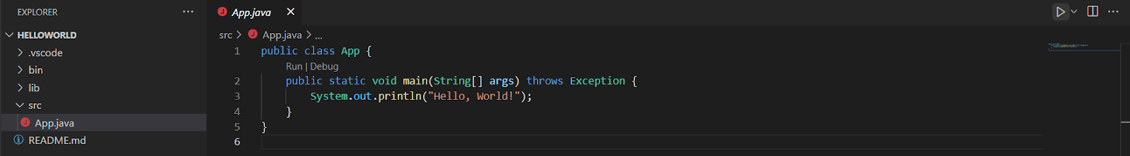
VS Code – Writing your first program
With IDE, you can press play and run your java code.
You can run your code using the ▶️ button (marked above)
‹#›

Slide 52
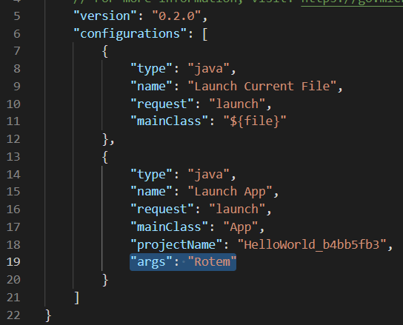
VS Code – command line arguments
To run your program with command line arguments:
Click run->open configurations
A file named “launch.json” will pop up
At the end of this configuration file, add the line: "args": ”your arguments”:
For the command line argument Rotem:
Running the program with the play button will now run it with the written arguments
‹#›

Slide 53
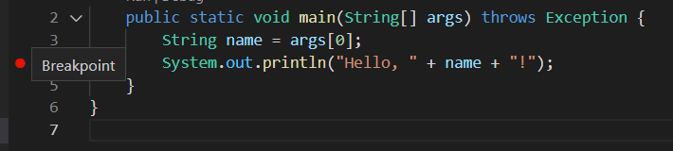
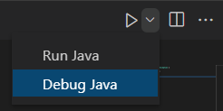
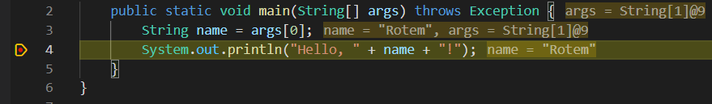
VS Code – Debugging
Programs can be debugged using breakpoints (marked by a red circle)
Add a breakpoint by pressing on the left of the row
Run on debug mode by clicking the small arrow on the right of the play button and choose “Debug Java”
The debugger will stop at the line of the break point
The values of the variables at the moment of the break will appear:
‹#›

Slide 54
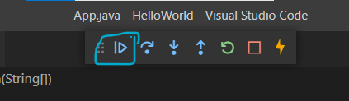
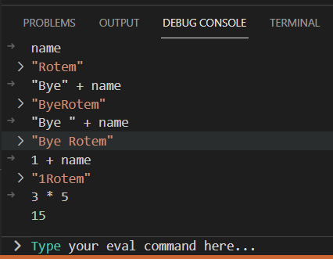
VS Code – Debugging
You can continue to the next breakpoint or step one line:
You can change the values of your variables and experiment with different lines of code by using the “DEBUG CONSOLE”
‹#›
Notes:
Mention step over, step into, step out.

